Slide 1






Slide 2
Outline of Coverage
Assets = Liabilities + Equity
Financial Statements
Common Stock Equity
Ratio Analysis

Slide 3






Slide 4
Assets = Liabilities + Equity
Most important equation in business
So, what does it mean? It means you can get assets through liabilities or equity.
So, what does that mean? That means you can get assets (like cash, factories or land) through taking on debt (loans from the bank, issuing bonds) or equity (relinquishing partial ownership interest in your company)

Slide 5
What Exactly are Assets?
Simplified Definition of an Asset: Cash or anything that will produce cash in the future.
More exact definition: is anything owned by an individual or a business, which has commercial or exchange value. Assets may consist of specific property or claims against others, in contrast to obligations due others.
Exact definition: Probable future economic benefits obtained or controlled by a particular entity as a result of past transactions or events.
Let’s keep it simple!
  For instance, if you had a factory that made computers, then it would be considered an asset.
    Why? Because the factory would produce cars that would be sold in the market for cash.
  Examples of assets include: cash, machinery, inventory, factory, land or anything else that will produce cash in the future.

Slide 6
What are Liabilities?
Simplified definition of liabilities: Anything that will reduce an asset (such as cash) in the future.
More exact definition: a loan, expense, or any other form of claim on the assets of an entity that must be paid or otherwise honored by that entity.
Exact definition: Probable future sacrifices of economic benefits arising from present obligations of a particular entity to transfer assets or provide services to other entities in the future as a result of past transactions or events.
Let’s keep it simple!
  For instance, if you owe your suppliers money for inventory then you would need to pay them at some point. Thus, you have liability until cash (an asset) was used to payoff the money owed.
  Example of liabilities include: Accounts payable, Loans outstanding, Unearned Services (occurs when you receive cash before performing your service)

Slide 7
What is Equity?
Simplified definition of Equity: The value of your company after you payoff all the money you owe.
More exact definition: ownership or percentage of ownership in a company or items of value.
Exact definition: Residual interest in the assets of an entity that remains after deducting its liabilities. In a business enterprise, the equity is the ownership interest.
Let’s keep it simple!
  For instance, you have a truck worth $20,000 (an asset), a factory worth $140,000 (an asset) and $30,000 of cash in the bank (an asset). If you sold the truck and the factory you would have $190,000 in cash and that would be your equity. However, you owe the bank $80,000 because you bought the car and part of the factory on a loan. Thus your equity after paying off your loan (liabilities), would only be $110,000.
  Examples of equity include common stock or simply one’s ownership of a private company (e.g. I own 28% of Mike’s Hard Lemonade Stand, while my other partners own the other 72%)

Slide 8


Slide 9
Financial Statements
There are 3 financial statements you must know:
  Balance Sheet
  Income Statement
  Cash Flow Statement

Slide 10
Balance Sheet
Elements of the balance sheet?
  Assets, Liabilities, & Equity
The balance sheet is where you find out how much cash you have and how much your truck and factory is worth.
The balance sheet shows a company at a moment in time (e.g. December 31, 2000).
  It is like taking a snapshot of the company at a split second and recording the financial position the company is in. You would count every truck and add up every bank account to come up with a value of your assets. You would then calculate how much money you owed and subtract that from your assets to determine your equity (Also known as “net assets”).

Slide 11
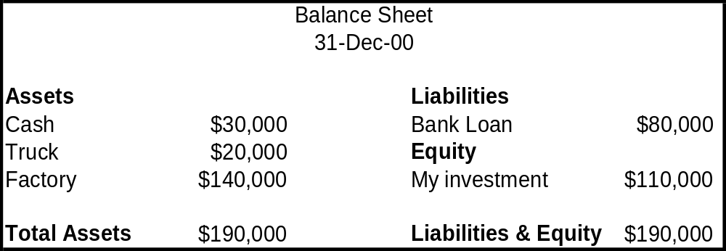
Balance Sheet Example
The balance sheet for the company we examined earlier would be the following:
Note that my debt is $80,000 and my equity is $110,000. This is because I bought the factory and the truck with a combination of my money (equity) and the bank’s loan (liability). In other words, I invested $110,000 of my money and $80,000 of the bank’s money to buy a truck, a factory and maintain a cash balance in the bank of $30,000.

Slide 12
Income Statement
The income statement presents the results of a company’s operations over a period of time.
The balance sheet and the income statement are linked and it is key that you understand this.
Think of the balance sheet as your cumulative GPA and think of each semester GPA as your income statement. Your cumulative GPA is affected by each semester and shows the net affect of all your efforts. Your semester GPA is earned over a specific period of time and refreshes each semester.
The results of operations as indicated in the income statement gets put into the balance sheet, similar to how each semester’s GPA get put into your cumulative GPA.

Slide 13
Income Statement
The income statement consists of revenues and expenses.
By subtracting revenues from expenses you arrive at net income.
Revenue is defined as inflows or other enhancements
Examples of revenue for a clothes company would be when they sell a shirt for $45.
  When this company sells this shirt it can then book $45 as revenue. Note it would not book $45 as net income because the costs of producing the shirt, designing the shirt and selling the shirt have not been considered

Slide 14
Income Statement
Net Income = Revenues – Expenses
A company makes a profit (net income) only if its revenues are greater than its costs
For example, if the $45 shirt cost a total of $63 to make and their were no other revenues or expenses then the net loss would be $18.

Slide 15
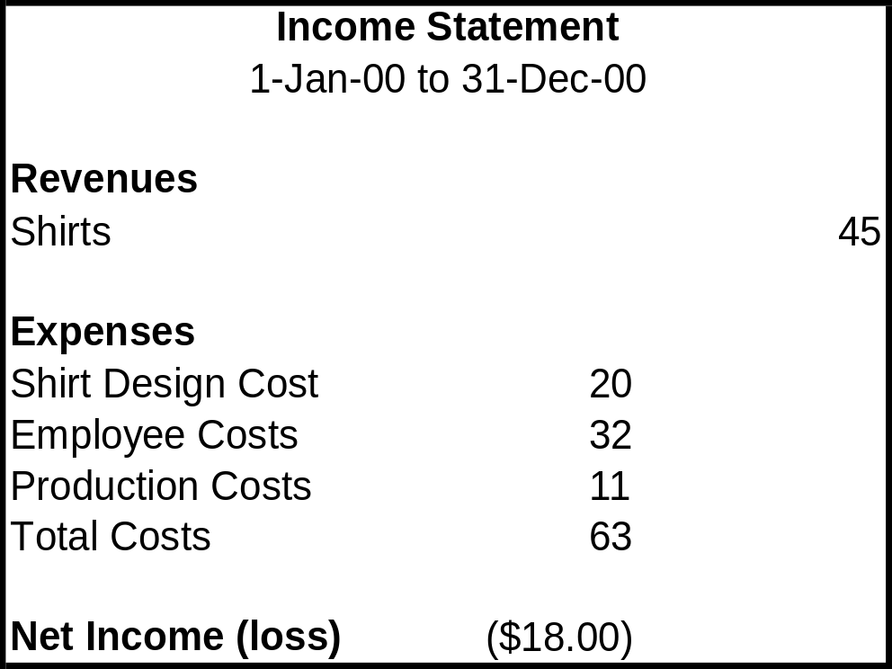
Income Statement
A simplified income statement is shown below:

Slide 16
The Major Link
The Balance Sheet has an account under the Equity section called Retained Earnings.
The Retained Earnings account accumulates all the net incomes or net losses that occur in every Income Statement.
The balance of retained earnings gives an total amount of money earned or lost since the business was created.
Hence, the balance in the Retained Earnings account is a good place to look to see if your company has destroyed or created value since its beginning. Companies like GE will have huge amounts of Retained Earnings, while newer companies will often have a negative balance in Retained Earnings

Slide 17
Statement of Cash Flows
Does net income of $500 equal a gain of $500 in cash?
  Absolutely NOT!!!!!
Cash flow and net income are completely different animals.
Remember the $45 shirt…if I had bought that shirt with cash then the net loss would be $18 and the cash lost would be $18. However, what if I bought the shirt on credit.
  In this case, the net loss would remain the same because the revenue would still be counted since a sale was made, however the cash flow would differ because no cash was exchanged.

Slide 18
Statement of Cash Flows
The statement of cash flows shows the actual cash inflows and outflows.
It shows cash inflows and outflows in 3 categories
  Cash Flows from Operations
  Cash Flows from Investing Activities
  Cash Flows from Financing Activities

Slide 19
Cash Flow Statement
Typically, a healthy growing company that is making a profit will show a positive Cash Flow from Operations because it making a profit.
A negative Cash Flow from Investing Activities will most likely been seen for a growing company because the firm is investing in projects to grow
The cash flow from financing will most likely be positive as it will need external capital to continue its growth.

Slide 20
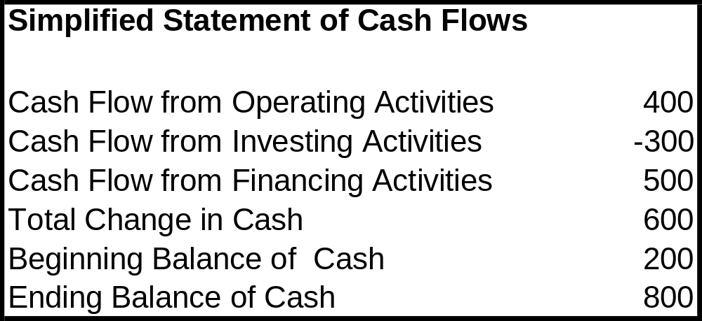
Cash Flow Statement
An example of a simplified Statement of Cash Flows

Slide 21


Slide 22
Common Stock Equity
Equity is the ownership stake in a company.
The equity of an incorporated company is represented by securities called stock.
Equity is the residual value of a company after all its liabilities have been paid.
Equity has both a book value and a market value.

Slide 23
Book Value of Equity
The book value of Equity can be found from the firms financial statements (balance sheet).
  Example: As shown from company ABC’s balance sheet, the book value of the equity is $66 million.

Slide 24
Market Value of Equity
Equity also has a market value. This can be calculated by taking the stock price of the company and multiplying it by the number of shares outstanding.
This gives an overall value for the firm.
For example if the stock price is $40 and there are 1,000,000 shares outstanding, that inherently means the market is valuing this company to be worth $40,000,000 after liabilities are subtracted.

Slide 25
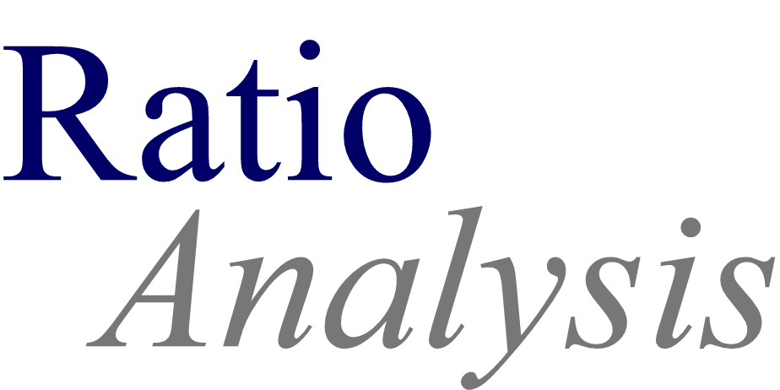

Slide 26
Important Ratios
There are several important types of ratios you should be concerned with when evaluating a company. They are the following:
  Liquidity Ratios
  Activity Rations
  Profitability Ratios
  Coverage Ratios

Slide 27
Liquidity Ratios
Liquidity ratios measure the short-run ability to pay maturing obligations.
Current Ratio = Current Assets/Current Liabilities
  Measures a companies short term debt paying ability.
  Higher is better.
Quick Ratio = Cash, marketable securities, and receivables (net)/ Current Liabilities
  Measures a company’s immediate short-term liquidity.
  Higher is better.
Current Cash Debt Coverage Ratio = Net Cash from Operating Activities/ Average Current Liabilities
  Measures a company’s ability to pay off its current liabilities in a given year from its operations.
  Higher is better.

Slide 28
Activity Ratios
Activity ratios measure the effectiveness of assets
Receivable Turnover = Net Sales/Average Accounts Receivables (net)
  Measures the liquidity of a company’s receivables.
  Higher is better
Asset Turnover = Sales/Total Assets
  Measures how much sales a firm can generate from its assets
  Higher is better.
Inventory Turnover = Cost of Goods Sold/Inventory
  Measures how well a firm is managing its inventory
  Higher is better.

Slide 29
Profitability Ratios
Profitability ratios serve as an overall measurement of firm performance.
Earnings per Share = (Net Income – Preferred Dividend)/ Weighted average shares outstanding
  Measures net income earned on each share of common stock
  Higher is better
Price to earnings ratio = Market price of stock/Earnings per share
  Measures the ratio of the market price per share to earnings per share
  Neither high or low is necessarily better. (Note: A high PE often means investors feel the company will have high levels of future growth).
Profit Margin on sales = net income/net sales
  Measures net income generated by each dollar of sales
  Higher is better.
ROA (Return on Assets) = Net Income / Avg. Total Assets
  Measures the overall profitability of assets
  Higher is better

Slide 30
Coverage Ratios
Coverage ratios are used to determine the leverage of a company and its ability to repay its debts.
Total Debt Ratio = Liabilities/Total Assets
  Measures the percentage of debt the company is financed by
  Typically lower is better.
Debt-to-Equity Ratio = Long-term Debt/Equity
  Measures how many dollars of long term debt the company is using for each dollar invested by its shareholders.
  Typically lower is better.
Interest Coverage = EBIT/Interest Expense
  Measures how many dollars of income are earned relative to interest expense.
  Higher is better.

Slide 31



Slide 32
Thanks for coming out!
Please email me, Bill Gushard at wrg112@psu.edu if you have any questions.
This PowerPoint presentation is on the reports page of our website (www.clubs.psu.edu/psia) for you to download, accessible from the home page of the site within the “Latest Reports” pull-down menu.

